Slide 1
VAT Issues Under EPA and OSHA
NESHAP
AHERA
MAP
OSHA

Slide 2
EPA NESHAP
Applicability under the NESHAP depends on the condition of the material when the work is done.
VAT is typically a Category I Non-friable ACM. However there are several things that could cause VAT to become RACM under the NESHAP:
  The condition of the VAT before work begins
  The condition it becomes because of the work
  Mechanical removal regardless of its condition

Slide 3
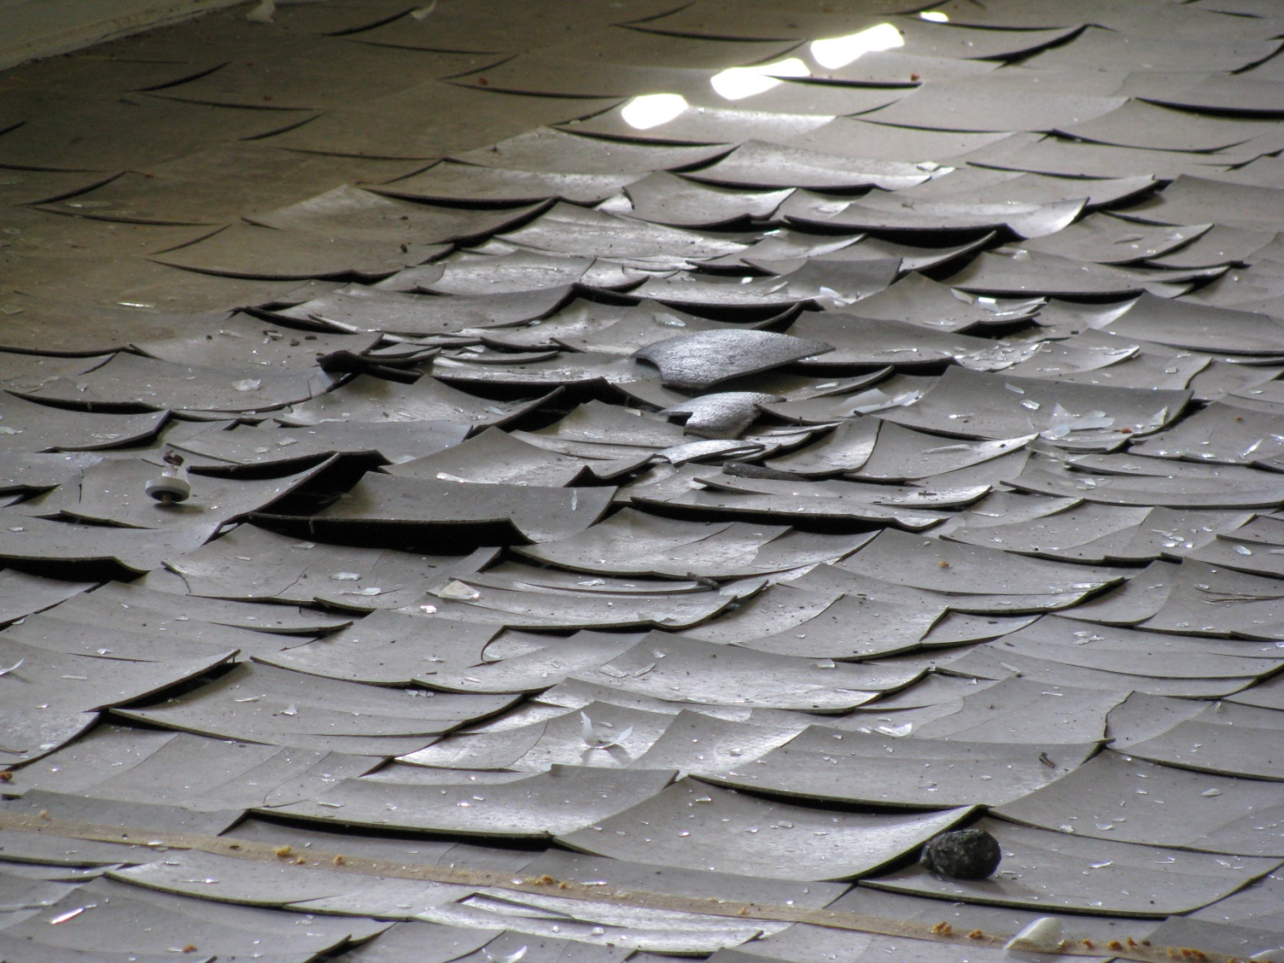
EPA NESHAP
The condition of the VAT before work:
If the VAT looks like this before work starts, most NESHAP jurisdictions would regulate it as RACM.

Slide 4
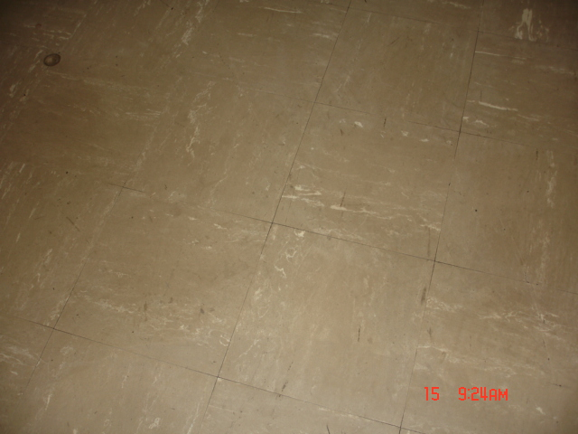
EPA NESHAP
The condition of the VAT before work:
If t he condition before work looks like this, It would be a Category I Non-friable ACM, and not regulated under the NESHAP.

Slide 5
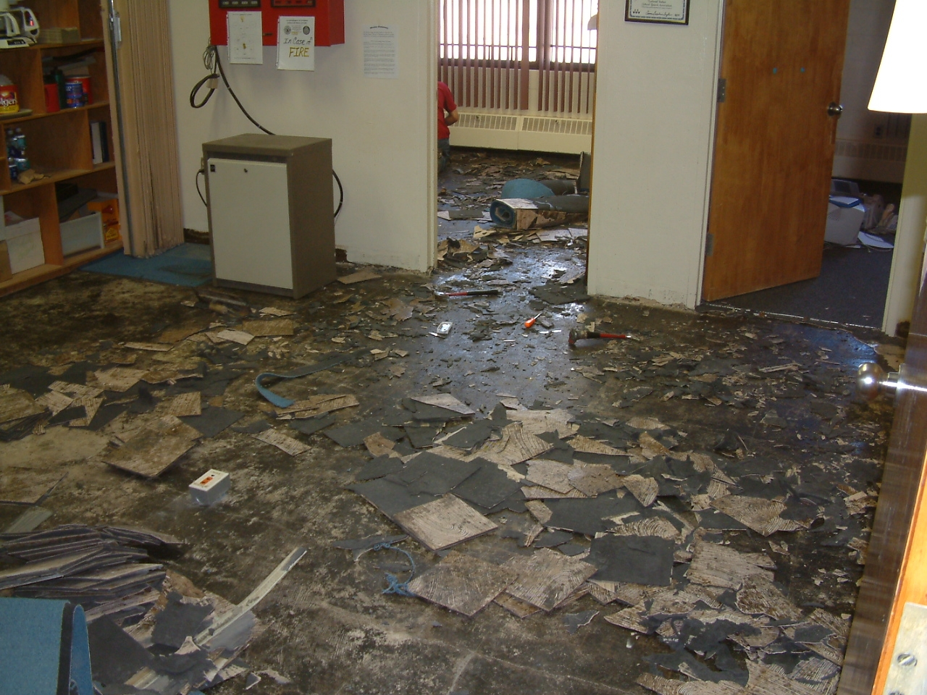
EPA NESHAP
The condition the VAT becomes because of the work:
If the VAT work area looks like this during the work, most jurisdictions would regulate the work as RACM. Even though the small crumbles are not reduced to powder, and the work was done by hand, most states and local jurisdictions would regulate this work. There are ways to remove the material substantially intact.

Slide 6

EPA NESHAP
Mechanical removal causes the VAT to be regulated regardless of friability:
EPA has ruled that mechanical removal causes the VAT to be regulated as RACM. It is not that mechanical removal should not be used if it is the most efficient method, but it will trigger notification, perhaps fees, NESHAP work requirements, waste shipment records and a regulated waste stream.

Slide 7
EPA NESHAP
In summary, as long as the VAT is Category I, it is simply not regulated under the NESHAP, even to the point of demolishing the building with the VAT in place. If it stops being Category I, it becomes RACM, and is fully regulated under the NESHAP.
Breaking the VAT during hand removal does not render the material friable, and does not cause it to become RACM.
However, do not crumble or pulverize the material.

Slide 8
EPA NESHAP
The mastic beneath VAT is usually ACM.
Typically, it is not RACM, but it is Category II Non-friable ACM. This just means that it is not regulated if you do not cause it to become RACM (grinding, sanding or any mechanical removal method).
It is not required to be removed before demolition, and may be demolished in place with the building.

Slide 9
AHERA
AHERA applies in schools, k-12.
AHERA requires special controls on “response action” work in the building.
Response actions require certified specifications, Certified Contractor/Supervisor to oversee the work, accomplished by certified Workers and final clearance before reoccupancy.
Typical VAT removal is not response action work.
Response action work addresses friable or TSI work only, not VAT removal.

Slide 10
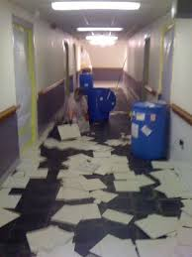
AHERA
Therefore, unlimited amounts of VAT may be removed in an AHERA facility without requiring any of the response action controls (specifications, certified people or final clearance).
A person may choose to use regulated procedures, but they are not required.

Slide 11
MAP
The Model Accreditation Plan (MAP) requires response action controls in all buildings except residential through 10 units, all houses are exempt.
The MAP requires certified people to do response action work.
Again, “response action” refers to friable or TSI removal, not non-friable material like VAT.

Slide 12
OSHA
Under the OSHA construction standard, Class I material (friable surfacing or TSI) is heavily regulated for removal, requiring certified people, respirators, protective clothing, containment, shower decontamination, etc.
VAT is a Class II material, not a “high hazard” material.
A person may choose to use Class I controls, but they are not required.

Slide 13
OSHA
OSHA regulates, at least in part, on the basis of “intact” and “non-intact” (similar to EPA’s friable or non-friable).
Non-intact means that the matrix that binds the asbestos fibers has been destroyed, and the fibers are free to become airborne.
“Aggressive methods” (sanding, grinding) are what causes a material to become non-intact.
Do not use aggressive methods on VAT.

Slide 14
OSHA
A Negative Exposure Assessment must be made for all work with asbestos. This is simply a way to do the removal work that will not produce exposure to asbestos above the PEL (Permissable Exposure Limits)

