Slide 1
WORKER PROTECTION
Respirators
and
Protective Clothing

Slide 2
DISCUSSION TOPICS
The need for respirators
Respirator Types
Operating principals of respirators
Protection factors
Fit testing
Respirator Protection Program
Protective clothing

Slide 3
THE NEED FOR RESPIRATORS
Asbestos is an airborne human carcinogen
No cure for asbestos disease
Asbestos disease is dose-response related
Minimizing exposure will minimize disease

Slide 4
TYPES OF RESPIRATORS USED IN ASBESTOS WORK
Negative Pressure
Positive Pressure
Air Purifying

Slide 5
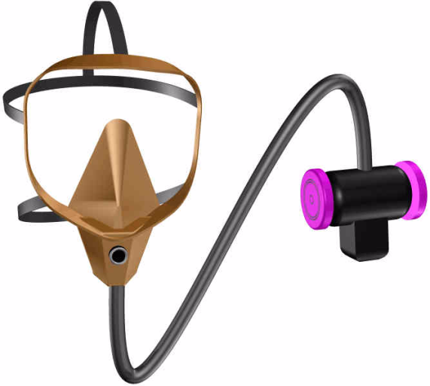
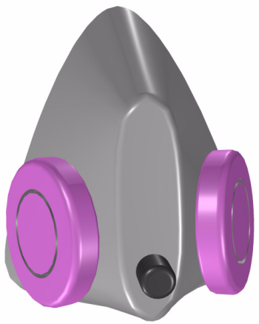

TYPES OF RESPIRATORS
Air Purifying: Uses the air around us, and purifies it with mechanical cartridge filters.
Half-Mask
Full-Face
PAPR

Slide 6
TYPES OF RESPIRATORS
Negative Pressure: When inhaling, negative pressure is created inside the facepiece, causing air to be drawn through the filters. Requires a leak-tight seal between the respirator and the face.
Half-mask
Full Face

Slide 7

TYPES OF RESPIRATORS
Positive Pressure: Clean air is forced into the facepiece, causing a positive pressure to exist inside the respirator. Any leaks will be clean air leaking out, not dirty air leaking in.
PAPR
POWERED AIR PURIFYING RESPIRATOR

Slide 8

OPERATING PRINCIPALS
HALF-MASK RESPIRATOR
One-way inhalation valve behind filter
Smooth, supple face seal. Must seal leak-tight to clean-shaven skin
High Efficiency Particulate Air (HEPA) filter. Purple or magenta in color.
Pliable silicon or rubber facepiece
One-way Exhalation valve. Probably the most critical working part of a respirator

Slide 9

OPERATING PRINCIPALS
FULL FACE RESPIRATOR
However, this respirator has 5 times the protection value as the half mask, because the face seal is easier to establish & maintain. This facepiece also has eye protection.
Same function of:
-Inhalation valve -Exhalation valve -HEPA cartridges -Face seal -(same parts)

Slide 10
OPERATING PRINCIPALS
Powered Air Purifying Respirator (PAPR)
Same full facepiece
HEPA filters
Exhalation valve
Battery pack & blower motor. 4-6 CFM. 8 or 12 hour battery when fully charged. Clips on belt.
This respirator has the advantage of positive pressure with mobility and long work periods. It is the standard respirator for the abatement contractor.

Slide 11
PROTECTION FACTORS
The Competent Person is responsible for ensuring & documenting adequate levels of respiratory protection for his workers.
The Protection Factor formula, along with the OSHA assigned protection factor values are used for that purpose at any given level of workplace exposure.

Slide 12
PROTECTION FACTORS
A measured exposure in the work area is 0.2 f/cc.
Which respirator is minimally required?
How clean do you want it inside the respirator?
O (outside)
I (inside)
PF =
OSHA PF
Half-mask 10
Full Face 50
PAPR 1000
0.2
0.1
At 0.1 f/cc:
= 2
0.2
0.01
At 0.01 f/cc:
= 20

Slide 13
MAXIMUM USE LEVEL CALCULATION
MUL = PF x PEL
OR
MUL = PF x Level Of Protection Desired
This calculation answers the question, “What is the dirtiest air I may use this respirator in?”
Example with the PAPR respirator:
1000 x .1 f/cc = 100 f/cc
or
1000 x .01 f/cc = 10 f/cc

Slide 14
RESPIRATORY PROTECTION PROGRAM
OSHA at 29 CFR 1910.134 requires a written Respiratory Protection Program which spells out the employers standard operating procedures, and is used by the employer as an element in training.
The written Respiratory Protection Program must be available at the jobsite, and must contain 9 required elements.

Slide 15
RESPIRATORY PROTECTION PROGRAM
1. Written SOP on selection & use
2. Medical evaluations
3. Fit testing procedures
4. Procedures for proper use
5. Cleaning, storing, inspecting, repairing, maintaining
6. Atmosphere-supplying respirator air management
7. Training in respiratory hazards
8. Training in proper use, limitations & maintenance
9. Procedures for program effectiveness evaluation

Slide 16
FIT TESTING
Fit testing is required for all tight fitting facepiece respirators annually!
This includes Positive pressure as well as negative pressure respirators.
There are two fit checks: - Negative pressure fit check - Positive pressure fit check
There are two types of fit tests: - Qualitative - Quantitative

Slide 17
FIT CHECKS
Negative pressure fit check: Cover the filter openings, and inhale slightly. The facepiece should “suck in” without breaking the seal.
Positive pressure fit check: Cover the exhalation valve, and exhale slightly. The facepiece should “puff up” without breaking the seal.
These must both be done every time the respirator is donned.

Slide 18
FIT TESTING
Qualitative fit testing: While wearing a respirator, the user is exposed to a test substance which he/she may detect. This is a pass - fail test. Usually done in-house.
Quantitative fit testing: A method of accurately measuring the leakage of a facepiece. The resulting “fit factor” must meet minimum criteria (Half face = 100; Full face = 500). Special equipment is required. Usually done by an outside technician or lab. More accurate & expensive than Qualitative testing.

Slide 19
FIT TESTING
Qualitative fit test procedures:
  May be done by a competent person
  Follow procedures in Appendix A of the Respiratory Protection standard (1910.134)
  Document all the required elements of the fit test
  Fit test annually for all tight-fitting respirator facepieces
  Respirators may only be used to the limit of the half face respirator

Slide 20

PROTECTIVE CLOTHING
Required by OSHA:
“Whole body covering”+head,hands,feet
When exposure is above a PEL, or
No Negative Exposure Assessment, or
Large Class I work (25 l.f. or 10 s.f.)

Slide 21
PROTECTIVE CLOTHING
A “dirty skin” which can be taken off for decontamination.
For the purpose of keeping your clothing from becoming contaminated.
Must be put on before entering the work area.
Must be taken off when exiting the work area.

Slide 22
PROTECTIVE CLOTHING
3 Types of disposable coveralls:
Tyvek: An impermeable material -Non-breathable - 4 lb tear strength - High particulate holdout - Expensive
Spunbond: Loose weave polypropylene -Breathable -6 lb tear strength -Low particulate holdout -Inexpensive
Filtered: 2 layers of spunbond w/ filter medium between -Breathable -9 lb tear strength -High particulate holdout -Moderate cost -The choice for all inspector & maintenance work

Slide 23
PROTECTIVE CLOTHING
Gloves: Durability depends on the work being done. Disposable or non-disposable.
Boots: Steel toe, waterproof protective footwear. Deck shoes or tennis shoes should not be worn.
Hard-hat: Should always be worn in the work area.
Eye Protection: Needed with the half-mask respirator, but not the full-face.

